Slide 1
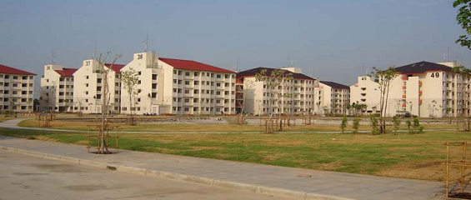
AN OVERVIEW OF Present low- income housing development by nha thailand
Thailand Housing Policy

Slide 3
Housing Policies
No comprehensive national housing policy
3 main government units implement government middle and low-income housing programs
Government Housing Bank (GH Bank), National Housing Authority (NHA) and Community Development Organization Institute (CODI)
Private sector provides housing from low-income to multi-million baht homes

Slide 4
Government Housing Bank
Specialized Financial Institution (SFI) – Ministry of Finance with major emphasis on lower and middle income mortgages
Special GH Bank’s Housing Loan Programs include
Government Pension Fund members housing loans
Baan Eur-Athorn
Board of Investment (BOI) low income housing programs
GH Bank First Home Project
Energy efficient projects
Saving for future home projects

Slide 5
National Housing Authority (NHA)
Assuring shelter for all residents in Thailand
Operates as state enterprise
Rental apartments, condominium, government employee housing
Currently, primarily acts as an enabler between government and private sector

Slide 6
Community Organization Development Institute (CODI)
Finance slum-area communities
Develops community-based savings programs and organization through co-operatives
Funded from Government budget
Baan Mankong program – very successful
Since 2003, CODI has funded more than 77,000
households in more than 245 districts throughout
Thailand

